Slide 1
Object-Oriented Programming (OOP)
Week – 01
Jan 20-24, 2019
Instructor: Basit Ali
Object-Oriented Programming (OOP)

Slide 2
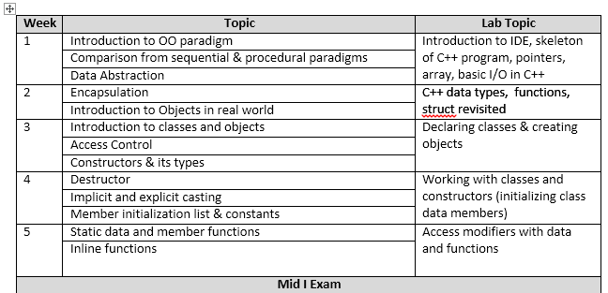
Course Outline

Slide 3
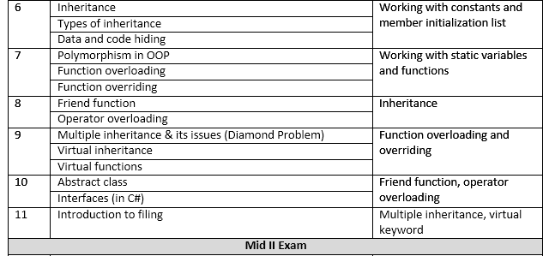
Course Outline

Slide 4
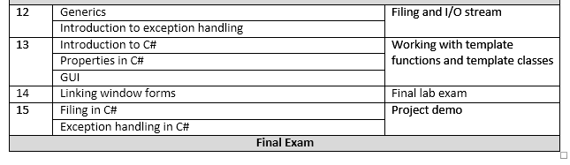
Course Outline

Slide 5
Books
“Problem Solving with C++”, 9th edition, Walter Savitch
“C++ How to Program” , 7th edition, Deitel & Deitel
C++ the complete reference, 4th edition - herbert schildt
Compiler: VS code

Slide 6
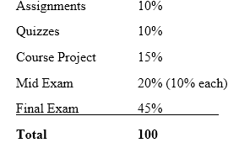
Marks Distribution (Assessments / Grading)

Slide 7
Programming Paradigms
1- Sequential
2- Procedural
3- Object Oriented

Slide 8
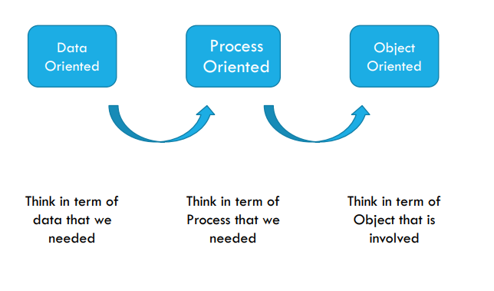
Programming Paradigms

Slide 9
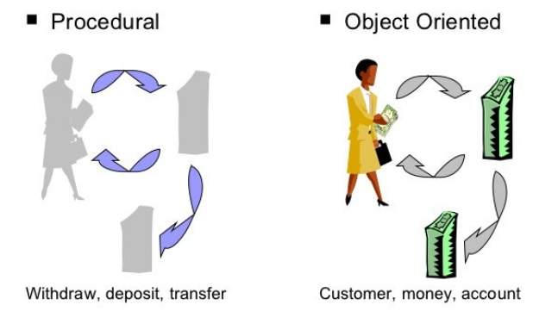
Procedural vs. Object-Oriented Programming

Slide 10
Procedural vs. Object-Oriented Programming
The unit in procedural programming is function, and unit in object-oriented programming is class
Procedural programming concentrates on creating functions, while object-oriented programming starts from isolating the classes, and then look for the methods inside them.

Slide 11
What is a Model?
A model is an abstraction of something
Real World Entities
Purpose is to understand the product before developing it

Slide 12
Examples – Model
Highway maps
Architectural models
Mechanical models

Slide 13
Example – OO Model

Slide 14
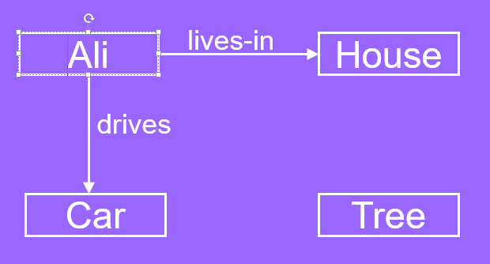
…Example – OO Model
Objects
Ali
House
Car
Tree
Interactions
Ali lives in the house
Ali drives the car

Slide 15
Object-Orientation - Advantages
People think in terms of objects
OO models map to reality
Therefore, OO models are
easy to develop
easy to understand

Slide 16
Class and Object
A class is a data type that allows programmers to create objects. A class provides a definition for an object, describing an object’s attributes (data) and methods (operations).
An object is an instance of a class. With one class, you can have as many objects as required

Slide 17
Structure V/S Class

Slide 18
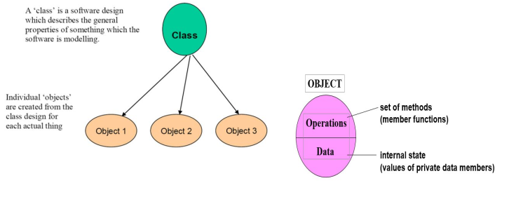
Class and Object

Slide 19
What is an Object?
An object is
Something tangible (Ali, Car)
Something that can be apprehended intellectually (Time, Date)
An object has
State (attributes)
Well-defined behaviour (operations)
Unique identity

Slide 20
Concept: An object has behaviors
An object contains both data and methods that manipulate that data
An object is active, not passive; it does things
An object is responsible for its own data
But: it can expose that data to other objects

Slide 21
Example – Ali is a Tangible Object
State (attributes)
Name
Age
Behavior (operations)
Walks
Eats
Identity
His name

Slide 22
Example – Car is a Tangible Object
State (attributes)
- Color
- Model
Behavior (operations)
- Accelerate - Start Car
- Change Gear
Identity
- Its registration number

Slide 23
Data Abstraction
Abstraction means displaying only essential information and hiding the details.
Data abstraction refers to providing only essential information about the data to the outside world, hiding the background details or implementation.

Slide 24

Data Abstraction (Example)

Slide 25
Advantages of Information Hiding
Simplifies the model by hiding implementation details
Prevents accidental access
Prevents illegal access or manipulation

Slide 26
Concept: Classes form a hierarchy
Classes are arranged in a treelike structure called a hierarchy
The class at the root is named Object
Every class, except Object, has a superclass
A class may have several ancestors, up to Object
When you define a class, you specify its superclass
If you don’t specify a superclass, Object is assumed
Every class may have one or more subclasses

Slide 27
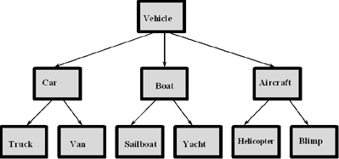
Example of (part of) a hierarchy
A class hierarchy for a vehicle rental company.

Slide 28
Exercise!
Scenario: A particular talent competition has 5 judges, each of whom awards a score between 0 to 10 to each performer. A performer’s final score is determined by dropping the lowest score received, then averaging the remaining 4 scores.
Task 1: Identify Attributes and functions.
Task 2: Procedural Programming approach?
Task 3: Object Oriented approach? (Model the problem: Identify class, objects)

